Slide 1
Getting development back on track
PAS Autumn Conference

Slide 2

Getting development back on track
What we’ll cover
Context & Scene Setting
Reflections from practice
Delivering a positive planning service - Blaby District Council
What can the planning system do?
Discussion & shared experiences

Slide 3
Who we are
The Homes & Communities Agency
The Homes and Communities Agency is the national housing, regeneration and social housing regulation agency for England.
Aligned public funding and delivery of local priorities
Local Growth
Affordable housing
Recoverable
Investment (debt/equity)
Regulation
Land
Our vision is for successful places with homes, jobs and economic growth

Slide 4


Who we are
ATLAS
Advisory Team for Large Applications
Impartial & independent advice
Supporting Local Authorities on large scale complex schemes
Non-statutory advice
Currently helping 50-60 Local Authorities
Notes:
We are the people who help get things done:
Supporting local authorities and communities deliver what they want, in the way they want, where they want it
Local Investment Plans are tailored to each area, focusing on local needs and aspirations – bottom-up approach to investment
Enabling = Working with people and places to deliver new homes, economic
growth and jobs
Land = Both HCA and wider government land. Economic Assets from the
RDAs.
Investment = Delivering programmes of investment in places
Affordable homes programme
Decent homes backlog programme
Land and regeneration
Regulation = From April 2012 the HCA became the regulator of social
housing providers, focusing on good governance, financial viability and value for money in Private Registered Providers as the basis for robust economic regulation.

Slide 5
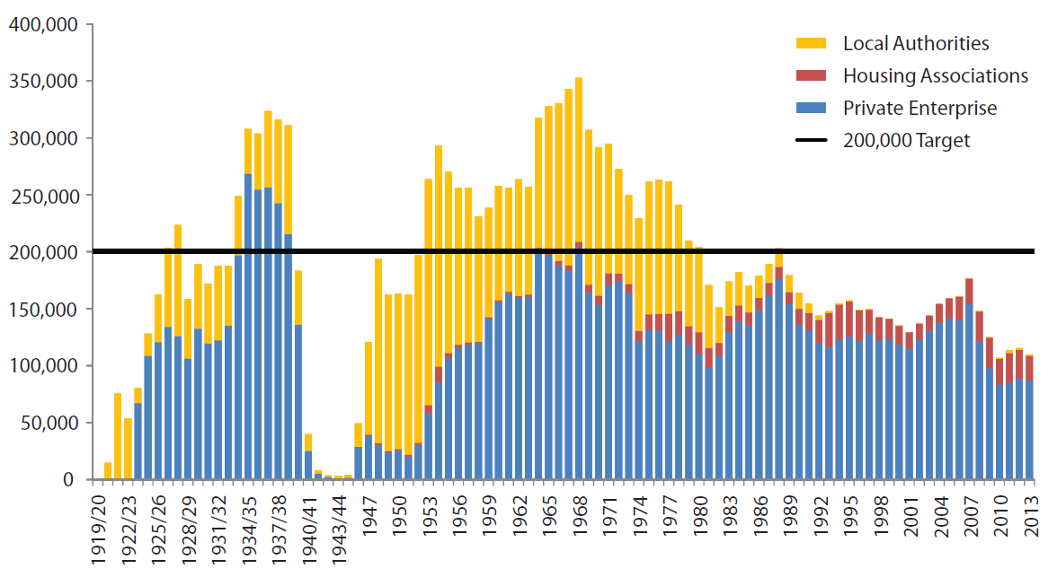
Context
Annual Housing Completions
Source: Lyons Review 2014 (based upon DCLG data)

Slide 6
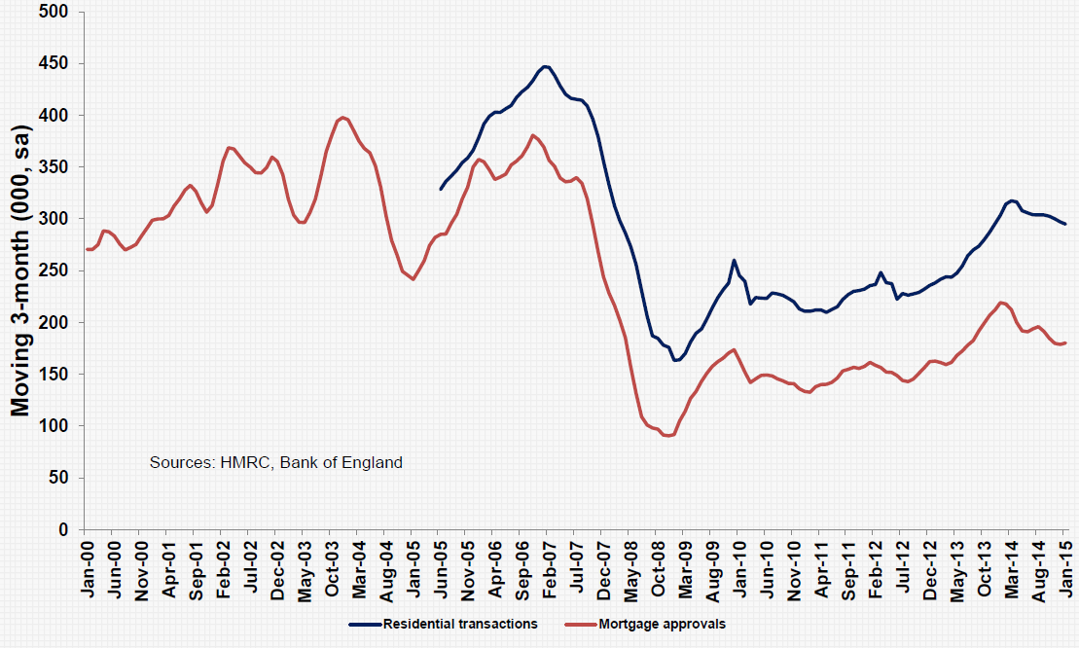
Context
Residential transactions & mortgages

Slide 7
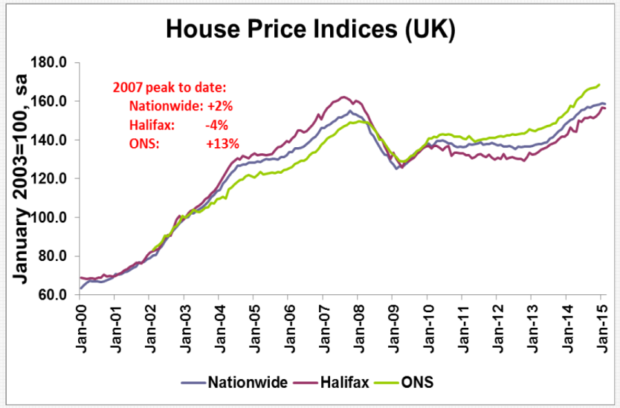
Context
House prices

Slide 8
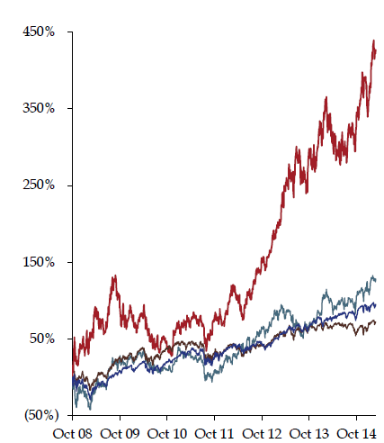
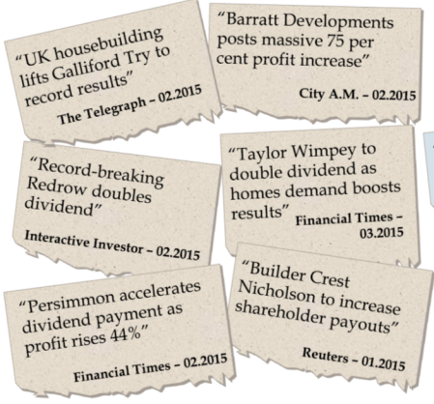
Context
Sector performance
UK Housebuilders + 427%
FTSE
All share
+ 72%

Slide 9





Context
New Homes in the Planning Pipeline
3m
2.5m
Pre Planning, 486,000
2m
Obtaining Outline
Permission, 513,000
1.5m
Outline Granted, Working up Detailed Plans/RMs, 578,000
1m
Detailed Plans Subm = 221,000
0.5m
Started on Site, 315,000
Detailed Permission or Reserved Matters Granted, 620,000
Not Started, 305,000
0
Getting Permission
Data from Glenigan (2015) for DCLG

Slide 10
Context
New Homes in the Planning Pipeline
3m
As of September 2015, 620,000 units had either detailed permission or reserved matters granted compared with fewer than
2.5m
half a million in 2013: more projects being given the green light by planning authorities.
Pre Planning, 486,000
2m
Obtaining Outline
Permission, 513,000
1.5m
Outline Granted, Working up Detailed Plans/RMs, 578,000
1m
Detailed Plans Subm = 221,000
0.5m
Started on Site, 315,000
Detailed Permission or Reserved Matters Granted, 620,000
Not Started, 305,000
0
Getting Permission
Data from Glenigan (2015) for DCLG

Slide 11


Context
New Homes in the Planning Pipeline
3m
As of September 2015, 620,000 units had either detailed permission or reserved matters granted compared with fewer than
2.5m
half a million in 2013: more projects being given the green light by planning authorities.
Pre Planning, 486,000
2m
Obtaining Outline
Permission, 513,000
However, over 300,000 of projects with full permission are yet to make a start on site. Reflecting both the increase of permissions in the system, and the time it takes between getting permission and starting.
1.5m
Outline Granted, Working up Detailed Plans/RMs, 578,000
1m
Detailed Plans Subm = 221,000
0.5m
Started on Site, 315,000
Detailed Permission or Reserved Matters Granted, 620,000
Not Started, 305,000
0
Getting Permission
Starting
Data from Glenigan (2015) for DCLG

Slide 12
Context
New Homes in the Planning Pipeline
3m
As of September 2015, 620,000 units had either detailed permission or reserved matters granted compared with fewer than
2.5m
half a million in 2013: more projects being given the green light by planning authorities.
Pre Planning, 486,000
2m
Obtaining Outline
Permission, 513,000
However, over 300,000 of projects with full permission are yet to make a start on site. Reflecting both the increase of permissions in the system, and the time it takes between getting permission and starting.
1.5m
Outline Granted, Working up Detailed Plans/RMs, 578,000
1m
Detailed Plans Subm = 221,000
0.5m
Started on Site, 315,000
60-70% do start within 1 year
Why do others not progress?
Detailed Permission or Reserved Matters Granted, 620,000
Not Started, 305,000
0
Getting Permission
Starting
Data from Glenigan (2015) for DCLG

Slide 13
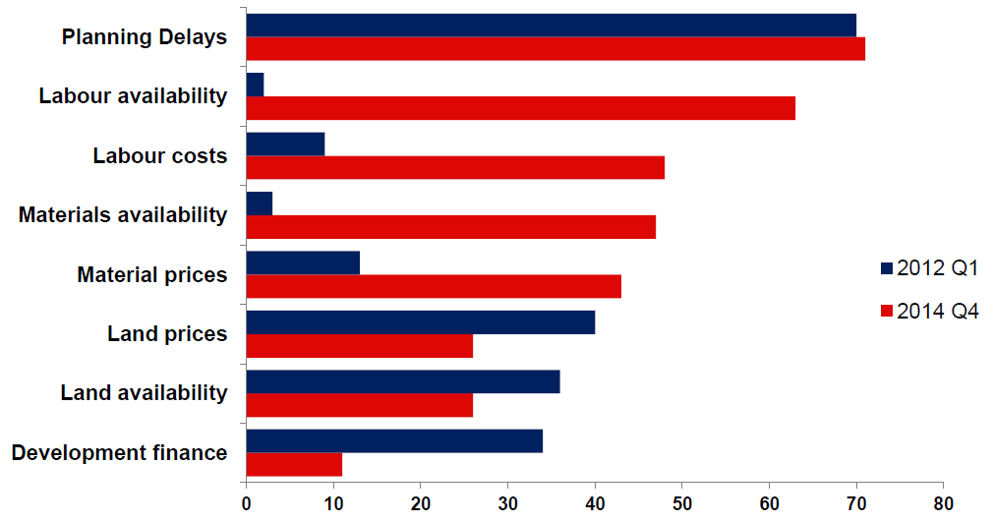
Context
The housebuilder perspective
2012 Q1
2014 Q4
Constraints on New Home Supply
% house builders quoting as “major constraint”
Source: Monthly Survey (HBF, 2015)

Slide 14

Context
Supporting Housing: LGA position
“The planning system is not holding back house builders from delivering the homes we need.”
Suggested planning measures
  Local fee setting
  More robust viability assessment process
  Access to growth funds
  Review CIL process & pooling
Other measures: skills to build, council capacity to build, better use of public land, RTB & social rent
Notes:
We are the people who help get things done:
Supporting local authorities and communities deliver what they want, in the way they want, where they want it
Local Investment Plans are tailored to each area, focusing on local needs and aspirations – bottom-up approach to investment
Enabling = Working with people and places to deliver new homes, economic
growth and jobs
Land = Both HCA and wider government land. Economic Assets from the
RDAs.
Investment = Delivering programmes of investment in places
Affordable homes programme
Decent homes backlog programme
Land and regeneration
Regulation = From April 2012 the HCA became the regulator of social
housing providers, focusing on good governance, financial viability and value for money in Private Registered Providers as the basis for robust economic regulation.

Slide 15
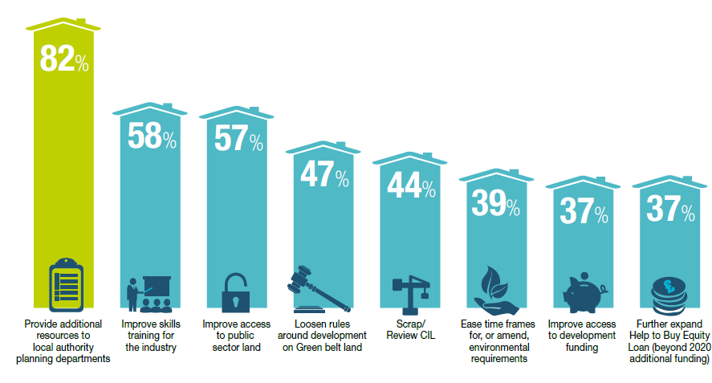
Context
What measures could boost housing supply
Source: Gaining Ground: Housebuilding Report 2015 (Knight Frank)

Slide 16
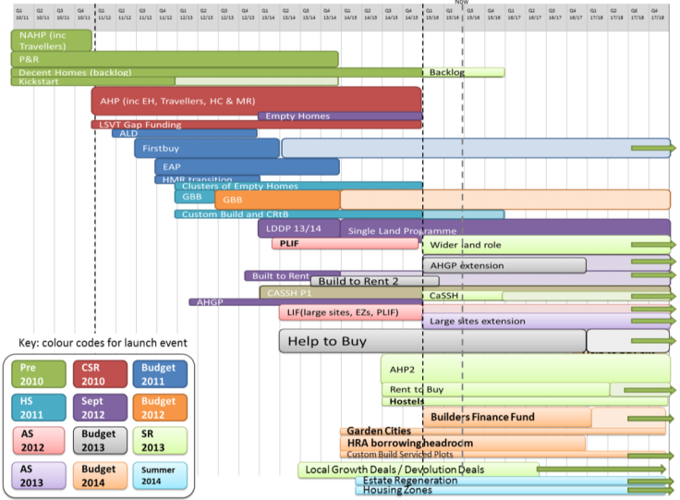
Context
A plethora of programmes

Slide 17

Reflections from practice
Discussions
In your groups, discuss your perspectives on the issues & challenges -
  Do you have examples of sites not progressing in your areas?
  Do you know why?
  What can be done?
  20 mins round table
  discussions
Notes:
We are the people who help get things done:
Supporting local authorities and communities deliver what they want, in the way they want, where they want it
Local Investment Plans are tailored to each area, focusing on local needs and aspirations – bottom-up approach to investment
Enabling = Working with people and places to deliver new homes, economic
growth and jobs
Land = Both HCA and wider government land. Economic Assets from the
RDAs.
Investment = Delivering programmes of investment in places
Affordable homes programme
Decent homes backlog programme
Land and regeneration
Regulation = From April 2012 the HCA became the regulator of social
housing providers, focusing on good governance, financial viability and value for money in Private Registered Providers as the basis for robust economic regulation.

Slide 18
Delivering a positive planning service
Kristy Ingles
Development Services Manager
Blaby District Council

Slide 19

Blaby District
The District covers 129km²
Situated in the East Midlands to the south west of Leicester
The District is made up of diverse settlements; being a mix of urban and rural settlements
Large scale business parks and many major business headquarters are located in the District
Unemployment rate of 0.8%
Population of 95,000; expected to increase to 102,000 by 2021
Average house price is 7.2 times the average salary in the District

Slide 20
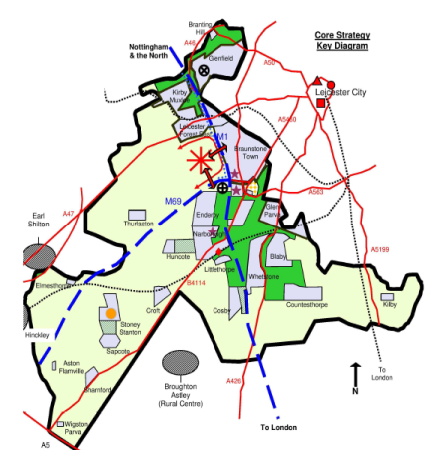
A Positive Planning Service
Fighting back from special measures
Comprehensive service approach
Customers
Members
Staff
What has worked well
On-going challenges

Slide 21
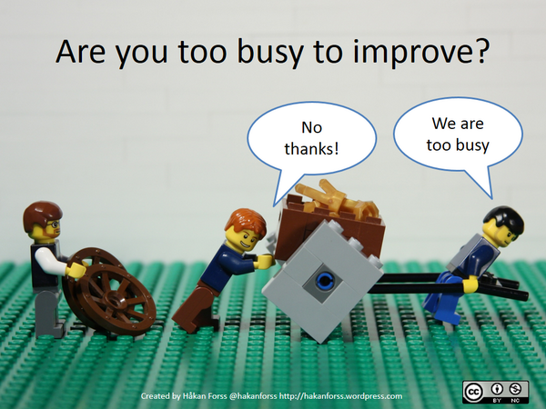

Slide 22

Start with good, reliable data

Slide 23


279

Slide 24
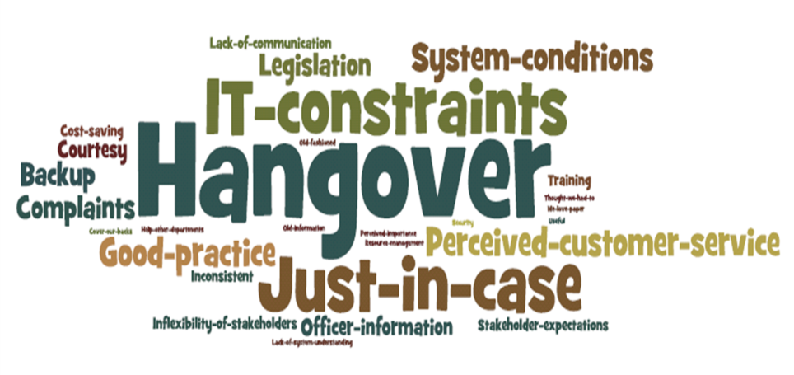

Slide 25

Our Purpose…
To ensure development is acceptable in planning terms.

Slide 26

Who are our Customers?
Our Customer…
  The person making an application or a pre-application request
  Everyone else is a
  Stakeholder
  The Planner!

Slide 27
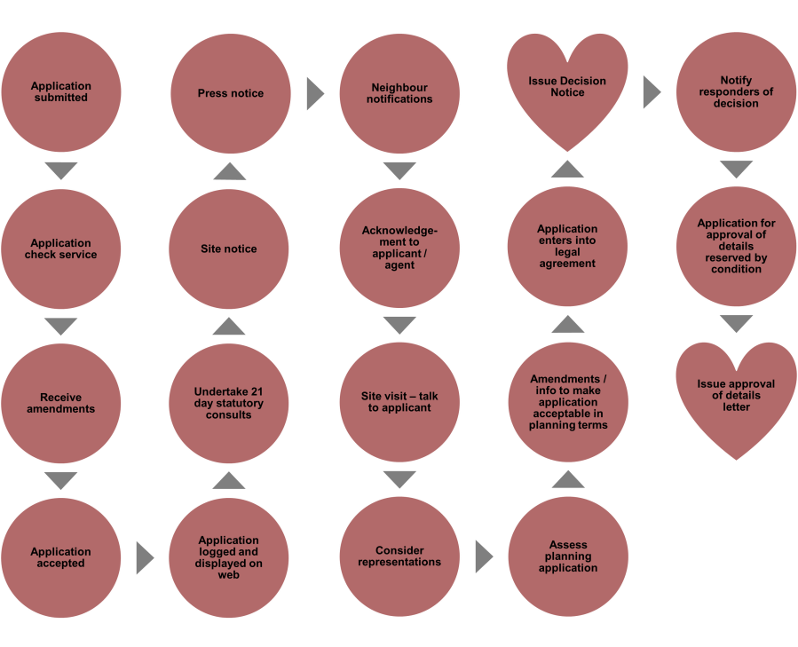

Slide 28
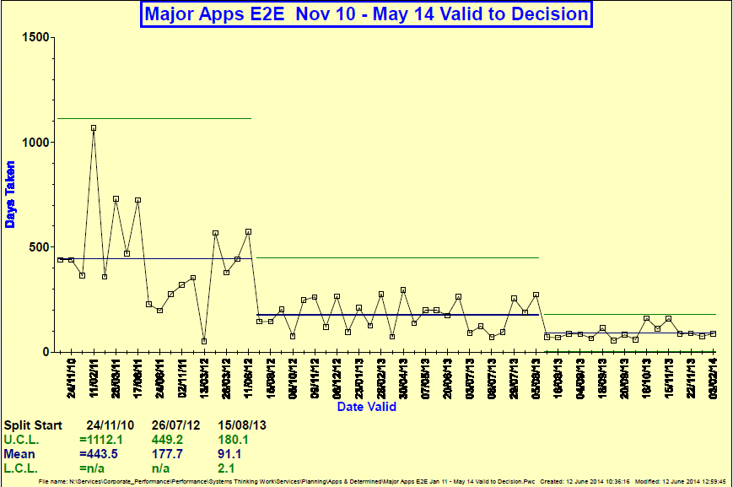

Performance
Blaby Lean Thinking

Slide 29

Savings - Financial
Blaby Lean Thinking

Slide 30

Savings - Time
Blaby Lean Thinking

Slide 31

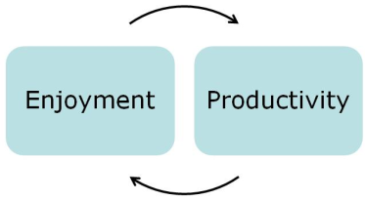

Morale

Slide 32
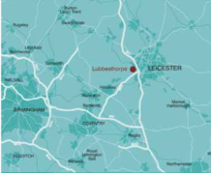
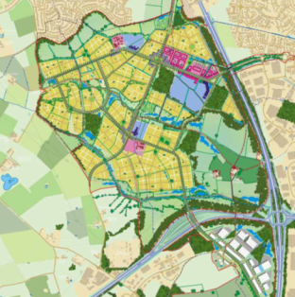
Lubbesthorpe New Community
Progressing key sites to approval
Compact and diverse sustainable new community to the west of Leicester (4,250 new homes)
21 ha employment
A proactive approach - project management and project plan
Corporate buy-in & leadership
Effective community, stakeholder & member engagement
Proactive approach to find solutions to infrastructure funding
Notes:
Set up nearly 3 years ago as a pilot project to help unblock major planning applications
We have a fairly unusual structure (PAS,CLG, EP) and whilst our primary ‘customer’ is local authorities we normally work with developers and other stakeholders providing impartial planning and development advice.
The key reason for our success is that we are perceived by all as being independent.

Slide 33

What can the planning system do
Potential tools & opportunities
A firm footing: establishing robust policy
A shared endeavour: securing positive collaboration
Making things happen: focus on delivery
Notes:
We are the people who help get things done:
Supporting local authorities and communities deliver what they want, in the way they want, where they want it
Local Investment Plans are tailored to each area, focusing on local needs and aspirations – bottom-up approach to investment
Enabling = Working with people and places to deliver new homes, economic
growth and jobs
Land = Both HCA and wider government land. Economic Assets from the
RDAs.
Investment = Delivering programmes of investment in places
Affordable homes programme
Decent homes backlog programme
Land and regeneration
Regulation = From April 2012 the HCA became the regulator of social
housing providers, focusing on good governance, financial viability and value for money in Private Registered Providers as the basis for robust economic regulation.

Slide 34

What can the planning system do
A firm footing: robust policy
Vision & leadership
Corporate buy-in
Positive engagement
Testing Deliverability
Appropriate planning strategies
Tools: Local Plans, SPDs, Engagement Strategies, Delivery Strategies, Local Development Orders
Notes:
We are the people who help get things done:
Supporting local authorities and communities deliver what they want, in the way they want, where they want it
Local Investment Plans are tailored to each area, focusing on local needs and aspirations – bottom-up approach to investment
Enabling = Working with people and places to deliver new homes, economic
growth and jobs
Land = Both HCA and wider government land. Economic Assets from the
RDAs.
Investment = Delivering programmes of investment in places
Affordable homes programme
Decent homes backlog programme
Land and regeneration
Regulation = From April 2012 the HCA became the regulator of social
housing providers, focusing on good governance, financial viability and value for money in Private Registered Providers as the basis for robust economic regulation.

Slide 35
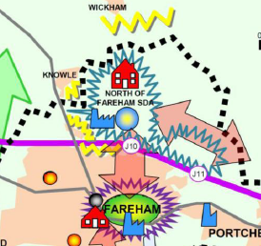
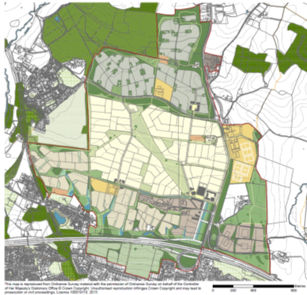
Welborne (North of Fareham)
Evolution of policy
Core Strategy
Adopted Aug 2011
The Welborne Plan: Draft
for consultation Apr 2013
Notes:
We are the people who help get things done:
Supporting local authorities and communities deliver what they want, in the way they want, where they want it
Local Investment Plans are tailored to each area, focusing on local needs and aspirations – bottom-up approach to investment
Enabling = Working with people and places to deliver new homes, economic
growth and jobs
Land = Both HCA and wider government land. Economic Assets from the
RDAs.
Investment = Delivering programmes of investment in places
Affordable homes programme
Decent homes backlog programme
Land and regeneration
Regulation = From April 2012 the HCA became the regulator of social
housing providers, focusing on good governance, financial viability and value for money in Private Registered Providers as the basis for robust economic regulation.

Slide 36
Welborne (North of Fareham)
Evolution of policy
Core Strategy
Adopted Aug 2011
The Welborne Plan: Draft
for consultation Apr 2013
Community Liaison Group
Visioning events
Primary schools
Cross Representative E-Panel
Residents & Business Surveys
Standing Conference
Social Media
Notes:
We are the people who help get things done:
Supporting local authorities and communities deliver what they want, in the way they want, where they want it
Local Investment Plans are tailored to each area, focusing on local needs and aspirations – bottom-up approach to investment
Enabling = Working with people and places to deliver new homes, economic
growth and jobs
Land = Both HCA and wider government land. Economic Assets from the
RDAs.
Investment = Delivering programmes of investment in places
Affordable homes programme
Decent homes backlog programme
Land and regeneration
Regulation = From April 2012 the HCA became the regulator of social
housing providers, focusing on good governance, financial viability and value for money in Private Registered Providers as the basis for robust economic regulation.

Slide 37
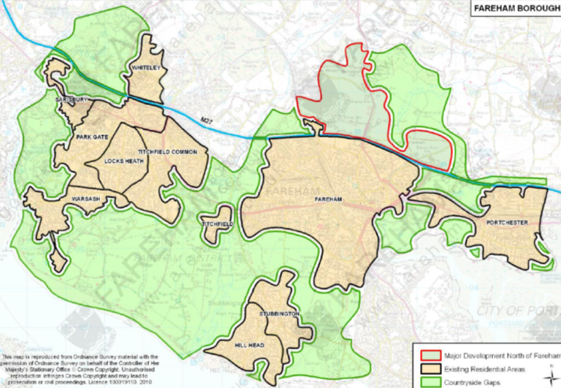
Welborne (North of Fareham)
E-panel Survey

Slide 38
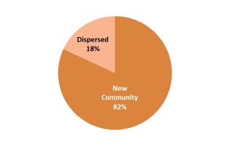
Welborne (North of Fareham)
E-panel Survey
Preferred location for housing to address need
New Community | 82%
Dispersed | 18%

Slide 39
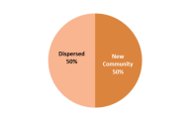
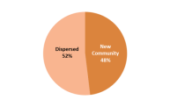
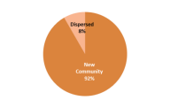
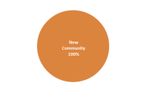
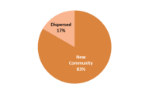
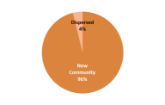
Welborne (North of Fareham)
E-panel Survey
Dispersed
50%
Dispersed
52%
Dispersed
Preferred location for housing to address need
New Community | 82%
Dispersed | 18%

Slide 40
Welborne (North of Fareham)
E-panel Survey
Key Facilities | No.
Primary schools | 344
Health centre | 324
Secondary school | 208
Shops | 182
Parks | 149
Community centres | 121
Play areas | 79
Supermarket | 49
Churches | 21
Dispersed
50%
Dispersed
52%
Dispersed
Preferred location for housing to address need
New Community | 82%
Dispersed | 18%

Slide 41

What can the planning system do
A shared endeavour: positive collaboration
Collective vision & objective setting
Front loading issues resolution
Framework for joint evidence
Active project management
Resource & work flow planning
Structure to engagement
Tools: PPAs, MoUs, Project Plans
Notes:
We are the people who help get things done:
Supporting local authorities and communities deliver what they want, in the way they want, where they want it
Local Investment Plans are tailored to each area, focusing on local needs and aspirations – bottom-up approach to investment
Enabling = Working with people and places to deliver new homes, economic
growth and jobs
Land = Both HCA and wider government land. Economic Assets from the
RDAs.
Investment = Delivering programmes of investment in places
Affordable homes programme
Decent homes backlog programme
Land and regeneration
Regulation = From April 2012 the HCA became the regulator of social
housing providers, focusing on good governance, financial viability and value for money in Private Registered Providers as the basis for robust economic regulation.

Slide 42
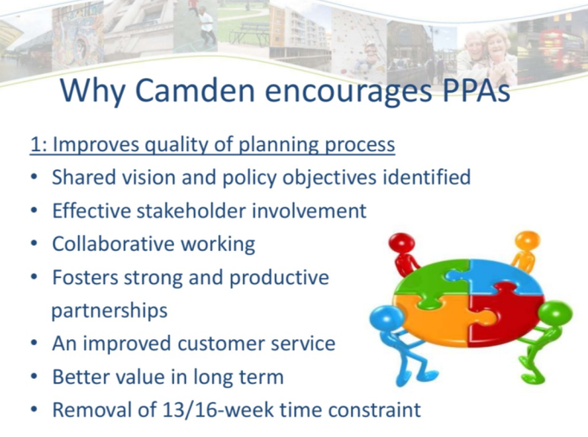
What can the planning system do
A shared endeavour: positive collaboration

Slide 43
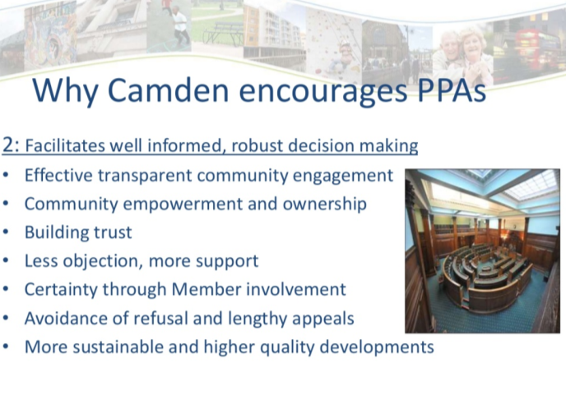
What can the planning system do
A shared endeavour: positive collaboration

Slide 44
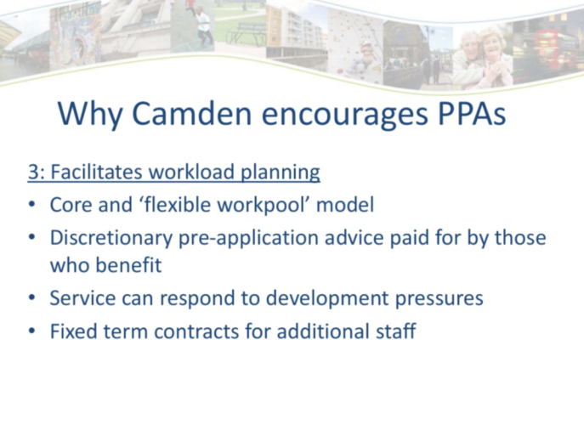
What can the planning system do
A shared endeavour: positive collaboration

Slide 45

What can the planning system do
Making things happen: focus on delivery
Understanding the problem
Local economic markets, skills & training
Scheme phasing flexibilities
Alternative funding & delivery opportunities
Addressing finance & cashflow needs
Tools: S106, CIL, NHB, CPO Powers, Public Sector Land, Growth & Investment Funds
Notes:
We are the people who help get things done:
Supporting local authorities and communities deliver what they want, in the way they want, where they want it
Local Investment Plans are tailored to each area, focusing on local needs and aspirations – bottom-up approach to investment
Enabling = Working with people and places to deliver new homes, economic
growth and jobs
Land = Both HCA and wider government land. Economic Assets from the
RDAs.
Investment = Delivering programmes of investment in places
Affordable homes programme
Decent homes backlog programme
Land and regeneration
Regulation = From April 2012 the HCA became the regulator of social
housing providers, focusing on good governance, financial viability and value for money in Private Registered Providers as the basis for robust economic regulation.

Slide 46

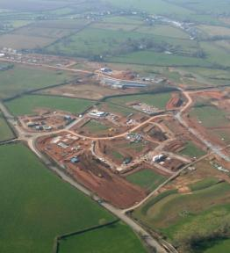



Cranbrook, East Devon
Delivering the vision
Policy & permissions in place
No appetite to renegotiate S106
Strong working partnership
Attracting public sector investment:
  Low Carbon funding £4m
  Affordable Housing £16m
  DfT funding £10m
  Local Infrastructure Fund £20m
Enabled start on site & delivery of agreed obligations
Notes:
Partnership approach via a dedicated Growth Point team – meaning partners are coordinated and have a strategic approach
Recognised form the outset that viability would be challenging, and they have been excellent to date about tracking funding opportunities and securing support for different parts of the project
A good illustration relates to environmental sustainability where the site will be one of the first to include a district wide heating network. Funding was challenging but they secured nearly £4m from the Low Carbon Infra Fund to help make it happen.
The overall mix of public funding secured to date includes:
The HCA investment in Cranbrook includes:
Infrastructure funding £1m
National Affordable Housing Programme £15.6m
Growth Point funding £6.3m
Community Infrastructure Fund £7m
Low Carbon Infrastructure Fund £3.6m
Other funding
Planning and support fees 0.1m
South West RDA funding through the Regional Infrastructure Fund £12m
Department for Transport – for Junction 29 £10.4m
Sub Total £56m
They are now mindful that infrastructure triggers are looming and they will need to maintain momentum. The cashflow for the project is a particular issue and partners are actively looking as to how to make sure the project doesn’t stall.
They are looking at innovative ways to make it work and evolving a concept of a Local revolving Infrastructure Fund. This could pool New Homes Bonus, CIL and local Business Rates to help deliver infrastructure over the lifetime of the growth strategy
Good example of a place bring focussed, proactive, innovative and taking some direct responsibility to help make it happen.

Slide 47

What can the planning system do
Preparing for further reform
Local Plan-making
Brownfield registers, permission in principle & fast-track certificate
200,000 Starter Homes
Housing & NSIP
Right to Build
S106 dispute resolution
Reform compulsory purchase
Planning performance
Simplifying and speeding up neighbourhood planning

Slide 48
What can the planning system do
Discussion & shared experiences
Your perspectives on the tools & opportunities
  What are your experiences – what has worked well / not so well?
  What else do you think could be done in your area?
  Which aspects of further reform may help most?
  What else should be addressed?
Notes:
Integral part of spatial planning process – putting spatial development plans into action
End to end management of delivery chain for sustainable development
Cultural change underlining role of LA as place shaper in partnership
The process for considering proposals needs to be proportionate and appropriate to the impact of individual development
DM approach necessitates changes in the structure and allocation of resources in LA
Planning Performance Agreements – encapsulate a development management approach of shared vision, collaboration and clear project coordination

