Slide 1
Sue Green
HBF Planning Manager –
Local Plans
PAS Autumn Conference
30th September 2015

Slide 2

A big patch
Midlands & South West Region
17 Counties
110 LPAs
35 Local Plan Examinations
Circa 40 DPDs no yet at examination

Slide 3
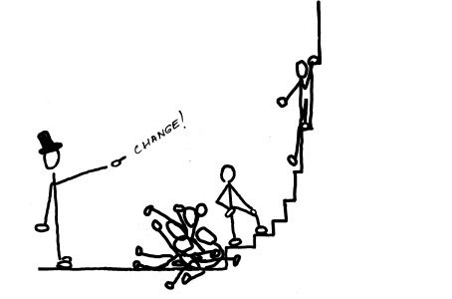
A steep learning curve
2011 - Duty to Co-operate
2012 - NPPF
2014 - NPPG

Slide 4


How developers can sabotage your Local Plan?

Slide 5

Have I sabotaged my own Local Plan?

Slide 6
Starting Points
Satisfied legal requirements of Duty to Co-operate
Submitted a sound plan for Examination Positively prepared
Justified
Effective
Consistent with national policy

Slide 7
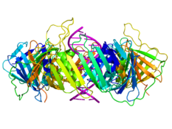
Plan making is complex

Slide 8


INCOMPLETE and / or INCORRECT

Slide 9

Incomplete
Jumping the gun

Slide 10

Incomplete
Not finishing the job

Slide 11

Incomplete
Not having the evidence

Slide 12

Incorrect
Going it alone

Slide 13

Incorrect
Changing your mind

Slide 14

Incorrect
Ignoring your own evidence

Slide 15

Incorrect
Ignoring advice

Slide 16

In conclusion
PLANNING

