Slide 1
Whole System Integrated Care Value Case DATE 2013

Slide 2
Guiding principles for the value case:
The overall goal of this work is to develop value cases which:
Aimed at Health & Wellbeing Boards
And incorporate:
Service user stories, capturing changes to the service user’s journey.
Features of the model, including enablers (e.g. technology initiatives to support the mode)
Costs of the model
Evidence of benefit, including to activity, spend and outcomes.
We recognise that the information contained in the value case may prompt further questions, in which case we recommend you use the contact details at the end of the value case to follow up with a direct contact.

Slide 3
Name of Area Value Case

Slide 4
About XXX
What experience was like before for a typical user
What experience is like now for a typical user

Slide 5
XXX Visual Model

Slide 6
Outcomes evidenced by XXX site: What difference does it make?
User experience
Frontline staff experience
Health & wellbeing outcomes
Impact on institutional care
Impact on cost
Productivity

Slide 7
How we did it: key enablers
Governance
.” am
Workforce Development and OD
Case management is run by a Multidisciplinary Team (MDT)
User and Carer Co-design
Case management is run by a Multidisciplinary Team (MDT)
Legal & contracting models
Financial enablers

Slide 8
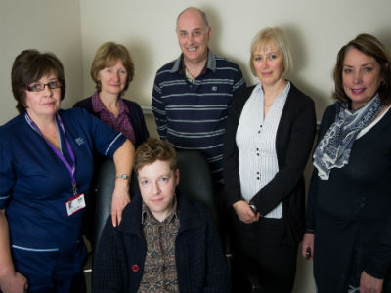
What we did: Integrated care design
Users and carers
Rapid Response Service
Case management is run by a Multidisciplinary Team (MDT)
Risk stratification
Case management is run by a Multidisciplinary Team (MDT)
Single point of contact
Respite care
Equipment

Slide 9
Who we did it for and why
Users and carers
Clinical Commissioning Groups
Case management is run by a Multidisciplinary Team (MDT)
Workforce
Case management is run by a Multidisciplinary Team (MDT)
Organisational boundaries
General public

Slide 10
Anticipated benefits
Benefits
Benefits
Users
Workforce
CCGs
Public
Benefits
Benefits

Slide 11
Lessons learned
Users & carers
Marketing
Case management is run by a Multidisciplinary Team (MDT)
State / Council support
Case management is run by a Multidisciplinary Team (MDT)
Financing barriers
Workforce
Leadership and relationships

Slide 12
Lessons learned
Outcome aimed for | Outcome achieved | Why?

Slide 13
Contact details
Contact details

